Slide 1
Data Analysis can be organized into 6 types
1. Exploratory Analysis
2. Descriptive Analysis
3. Inferential Analysis
4. Predictive Analysis
5. Causal Analysis
6. Mechanistic Analysis

Slide 2
Exploratory Analysis
The preliminary analysis of data to discover relationships between measures in the data and to gain an insight on the trends, patterns, and relationships among various entities present in the data set with the help of statistics and visualization tools is called Exploratory Data Analysis (EDA).
Exploratory data analysis is cross-classified in two different ways where each method is either graphical or non-graphical. And then, each method is either univariate, bivariate or multivariate.

Slide 3
Continue…
Exploratory Data Analysis refers to the critical process of performing initial investigations on data so as to discover patterns, to spot anomalies, to test hypothesis and to check assumptions with the help of summary statistics and graphical representations.

Slide 4
Introduction to Exploratory Data Analysis in R
To summarize the main characteristics of data analysis in R, EDA is the only approach with the help of descriptive statistics and visual methods.
It is not a formal process that contains a strict set of rules. More than anything, EDA is a state of mind.
During the initial phases of EDA, you should feel free to investigate every idea that occurs to you.
So, some of these ideas will pan out, and some will be dead ends.

Slide 5
Exploratory Graphs in Data Analysis
To understand data properties
For finding patterns in data
To suggest modeling strategies
To “Debug” analyses

Slide 6
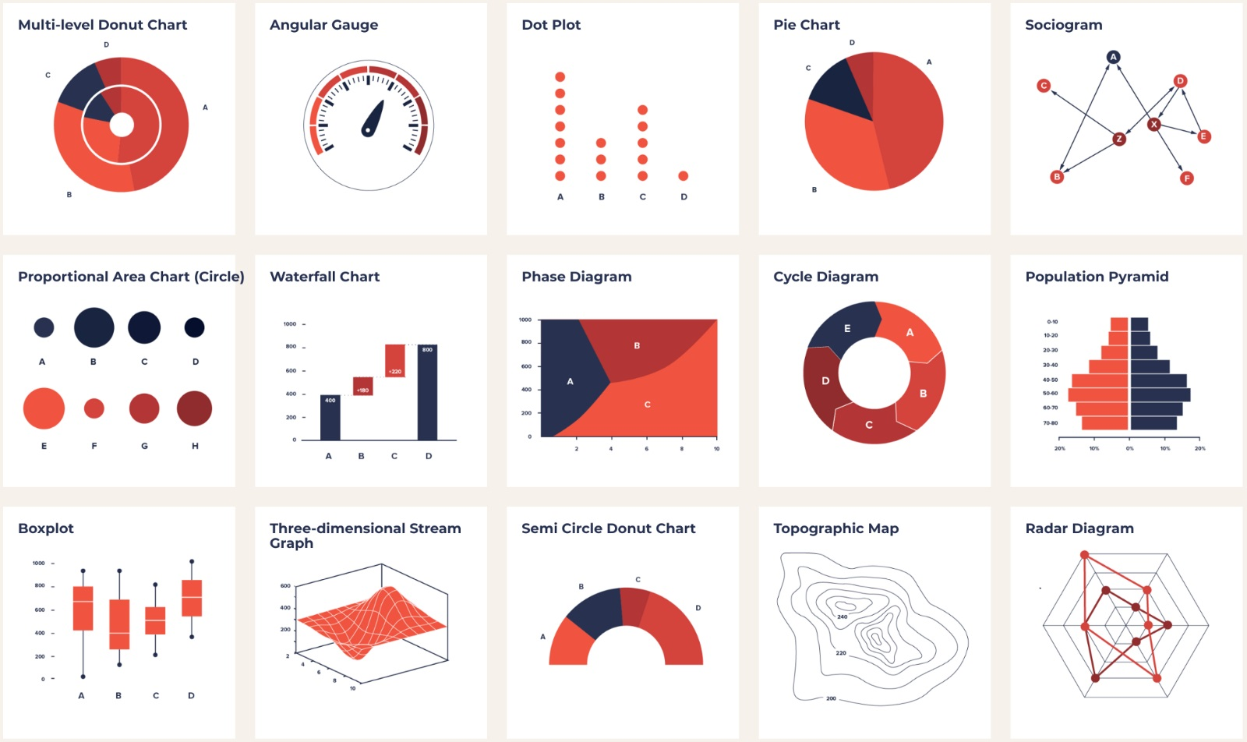

Slide 7
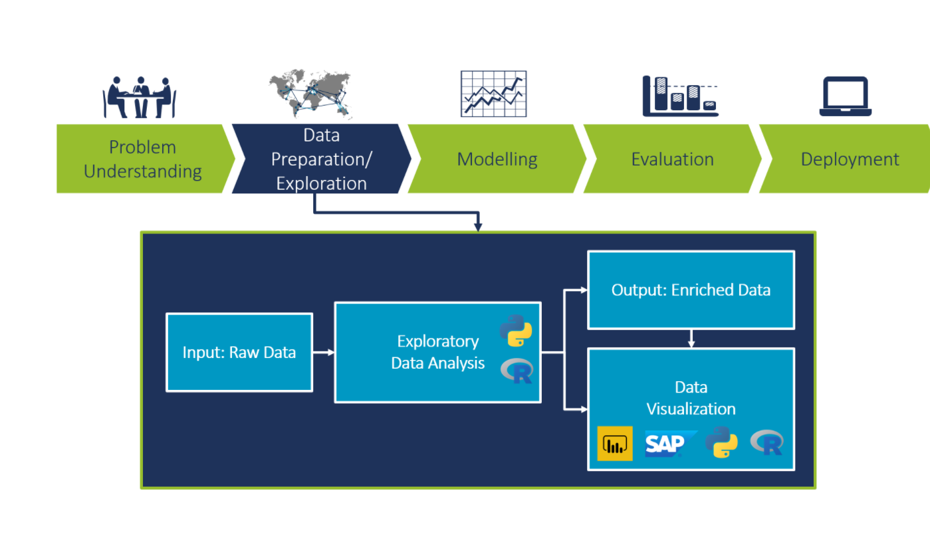

Slide 8
Exploratory Data Analysis
is a vital step in a data science project. The main pillars of EDA are data cleaning, data preparation, data exploration, and data visualization.
There are various exploratory tools
(Python and R),
enterprise applications (Power BI, SAP Cloud Analytics, Tableau, etc.)
to perform EDA, each of them offering a unique set of tools.

Slide 9
Some commonly used plots for EDA are:
Histograms: to check the distribution of a specific variable
Scatter plots: to check the dependency between two variables
Maps: to show distribution of a variable on a regional or world map
Feature correlation plot (heat map): to understand the dependencies between multiple variables
Time series plots: to identify trends and seasonality in time dependent

Slide 10
i. Variable
It is a quantity, quality, or property that you can measure.
Types of variables
a. Qualitative Variables
Variables take on values that are names or labels.
Ex. The color of a ball (e.g., red, green, blue) or the breed of a dog (e.g., collie, shepherd, terrier.
Types of Qualitative Variables
1. Nominal: Basically, it displays graphical data — all orderings are equally meaningful.
Ex. a student’s religion (Atheist, Christian, Muslim, Hindu, …) is nominal.
2. Ordinal: A categorical variable whose categories can be meaningfully ordered is called ordinal.
Ex. a student’s grade in an exam (A, B, C or Fail) is ordinal.

Slide 11
b. Quantitative Variables
Variables that can measure on a numeric or quantitative scale.
Ex. Age, count of anything etc.
Types of Quantitative Variables:
1. Discrete: A discrete variable is one that cannot take on all values within the limits of the variable.
Ex. The number of children is a discrete numerical variable (a count). The variable cannot have the value 1.7
2. Continuous: In this, the variable can take on any value between two specified values.
Ex. age of a human: 25 years, 10 months, 2 days, 5 hours

Slide 12
Dimensionality of Data Sets
Univariate: Measurement made on one variable per subject
Bivariate: Measurement made on two variables per subject
Multivariate: Measurement made on many variables per subject

Slide 13
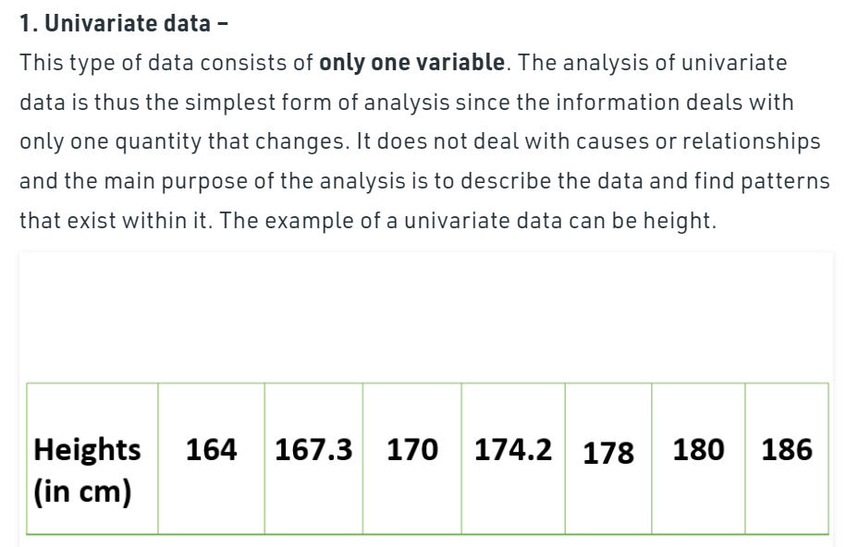

Slide 14
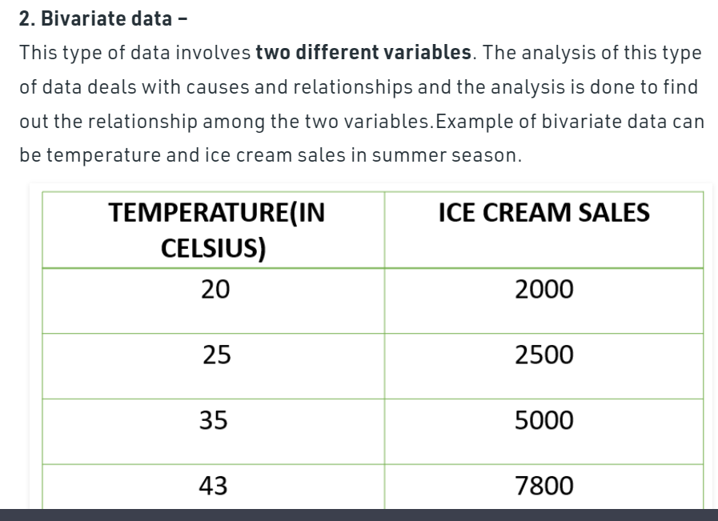

Slide 15
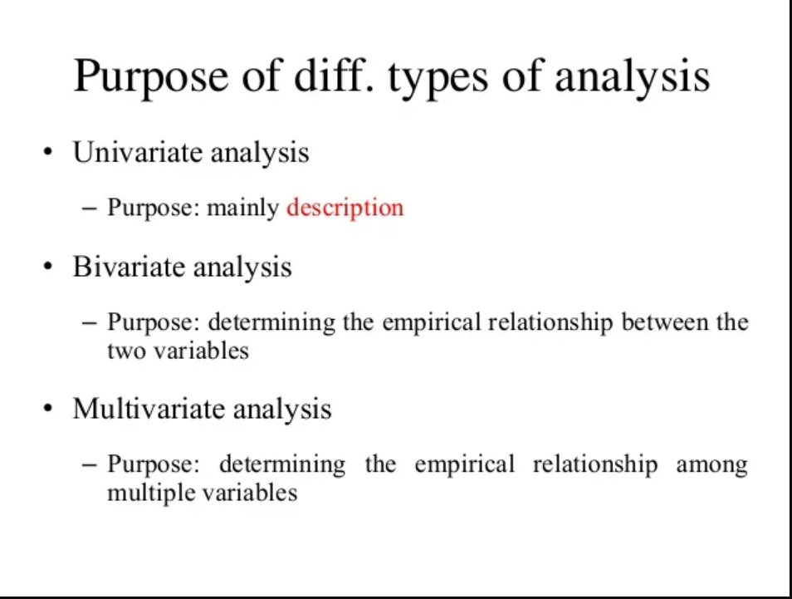

Slide 16
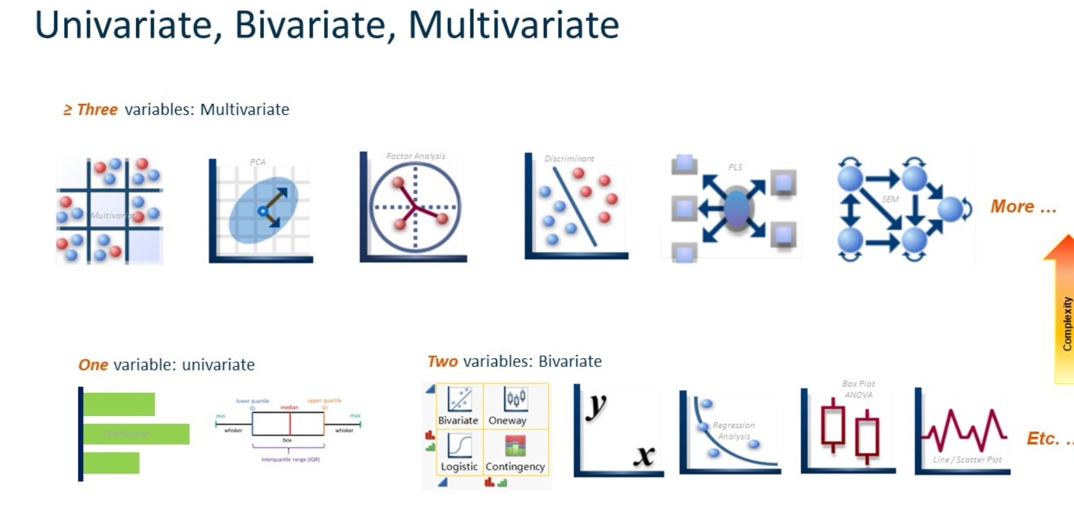

Slide 17
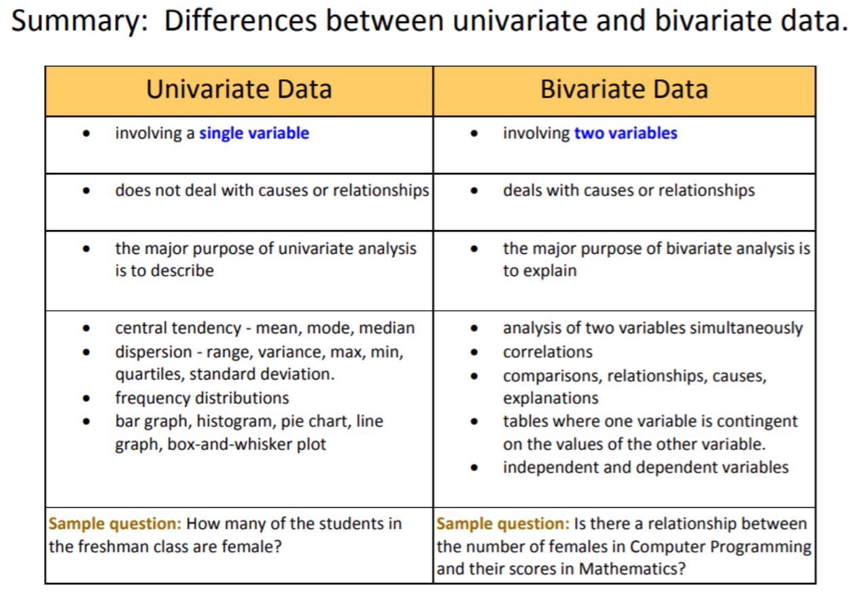

Slide 18
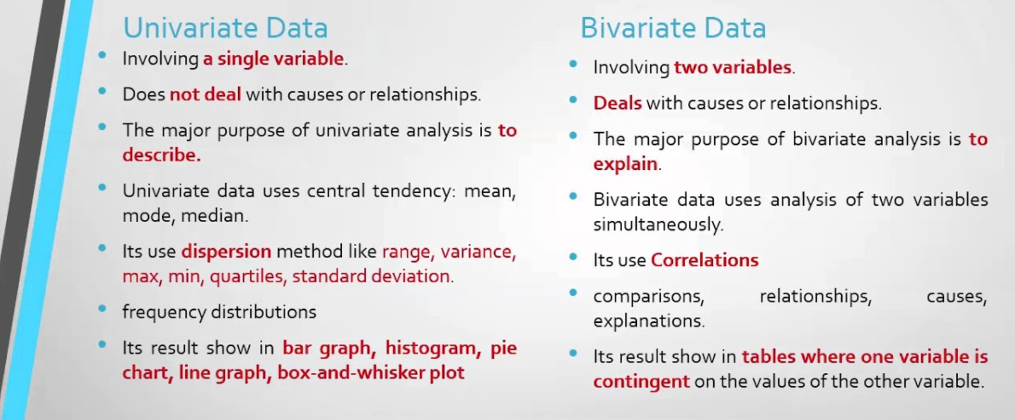

Slide 19
R Code for Histogram

Slide 20
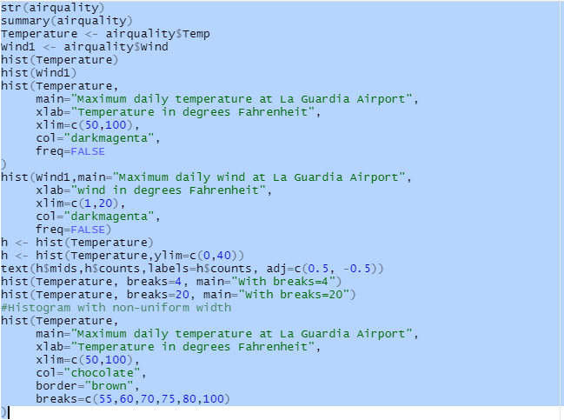

Slide 21
bivariate analysis
The term bivariate analysis refers to the analysis of two variables. You can remember this because the prefix “bi” means “two.”
The purpose of bivariate analysis is to understand the relationship between two variables
There are three common ways to perform bivariate analysis:
1. Scatterplots
2. Correlation Coefficients
3. Simple Linear Regression

Slide 22
Multivariate analysis
Data analytics is all about looking at various factors to see how they impact certain situations and outcomes. When dealing with data that contains more than two variables, you’ll use multivariate analysis. Multivariate analysis isn’t just one specific method—rather, it encompasses a whole range of statistical techniques. These techniques allow you to gain a deeper understanding of your data in relation to specific business or real-world scenarios. So, if you’re an aspiring data analyst or data scientist, multivariate analysis is an important concept to get to grips with

Slide 23
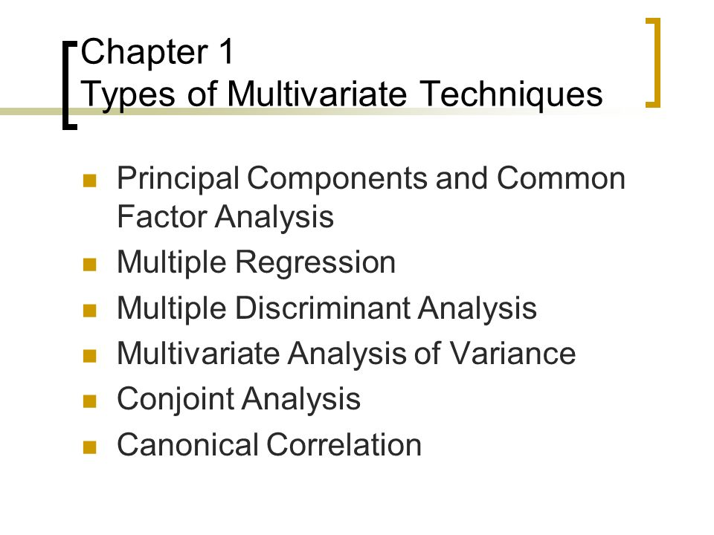

Slide 24
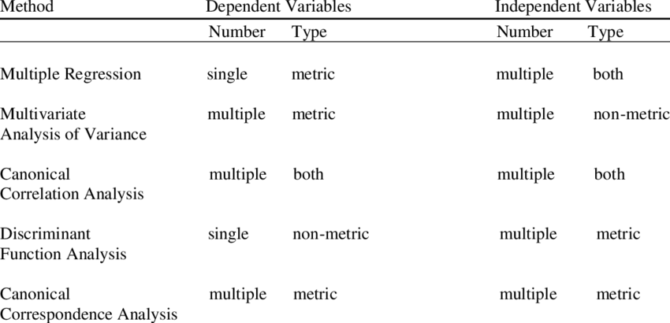

Slide 25
Multivariate data analysis techniques and examples
There are many different techniques for multivariate analysis, and they can be divided into two categories:
Dependence techniques
Interdependence techniques
y = b0 + b1*x1 + b2*x2 + b3*x3
The “b” values are called the regression weights (or beta coefficients).
They measure the association between the predictor variable and the outcome.
“b_j” can be interpreted as the average effect on y of a one unit increase in “x_j”, holding all other predictors fixed.

Slide 26
Dependence methods
Dependence methods are used when one or some of the variables are dependent on others. Dependence looks at cause and effect; in other words, can the values of two or more independent variables be used to explain, describe, or predict the value of another, dependent variable?
To give a simple example, the dependent variable of “weight” might be predicted by independent variables such as “height” and “age.”
In machine learning, dependence techniques are used to build predictive models.
The analyst enters input data into the model, specifying which variables are independent and which ones are dependent—in other words, which variables they want the model to predict, and which variables they want the model to use to make those predictions.

Slide 27
Interdependence methods
Interdependence methods are used to understand the structural makeup and underlying patterns within a dataset.
In this case, no variables are dependent on others, so you’re not looking for causal relationships.
Rather, interdependence methods seek to give meaning to a set of variables or to group them together in meaningful ways.
So: One is about the effect of certain variables on others, while the other is all about the structure of the dataset.

Slide 28
Multiple linear regression
Multiple linear regression is a dependence method which looks at the relationship between one dependent variable and two or more independent variables. A multiple regression model will tell you the extent to which each independent variable has a linear relationship with the dependent variable. This is useful as it helps you to understand which factors are likely to influence a certain outcome, allowing you to estimate future outcomes.

Slide 29
Continued…
Multiple regression is a statistical technique that can be used to analyze the relationship between a single dependent variable and several independent variables.
The objective of multiple regression analysis is to use the independent variables whose values are known to predict the value of the single dependent value.
MRA is a statistical procedure that assesses the relationship between a dependent variable and several predictor variables.
The estimates generated by MRA are called coefficients.

Slide 30
The aim of multivariate analysis is to find patterns and correlations between several variables simultaneously
Multivariate analysis is especially useful for analyzing complex datasets, allowing you to gain a deeper understanding of your data and how it relates to real-world scenarios
There are two types of multivariate analysis techniques: Dependence techniques, which look at cause-and-effect relationships between variables, and interdependence techniques, which explore the structure of a dataset
Key multivariate analysis techniques include multiple linear regression, multiple logistic regression, MANOVA, factor analysis, and cluster analysis—to name just a few

Slide 31
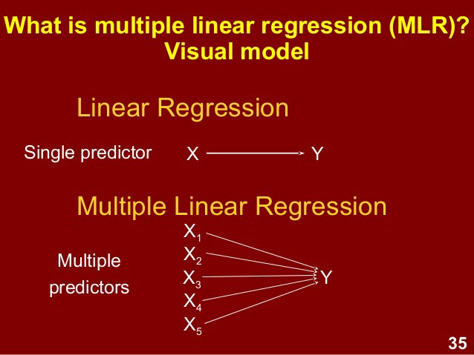

Slide 32
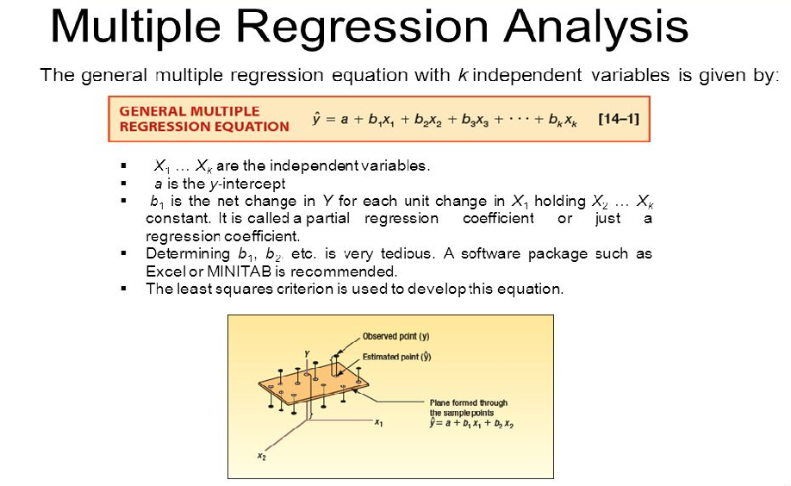

Slide 33
Multiple Regression Using R
Multiple regression is an extension of linear regression into relationship between more than two variables.
In simple linear relation we have one predictor and one response variable,
But in multiple regression we have more than one predictor variable and one response variable.

Slide 34
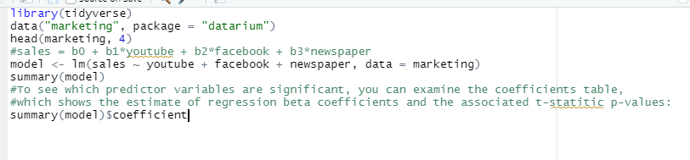
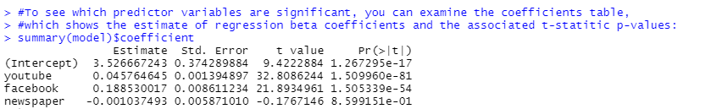

Slide 35
Useful Links
http://www.sthda.com/english/articles/40-regression-analysis/168-multiple-linear-regression-in-r/

Slide 36
Measurement and Metric
Measurement : It's an indication of the size, quantity, amount or dimension. For example - function point, lines of code, story point, feature point, defect, cost, kilometer, hour, meter, seconds, etc.
Metric : It is a measurement of degree or measure for something. A software metric is standard of measure of a degree. For example - Function point / person hour, cost/story point, defect density, lines of code/man days, km/hr, m/s etc. Metrics can be standard of measurement too.

Slide 37
T Test
It is a type of inferential statistic used to study if there is a statistical difference between two groups. Mathematically, it establishes the problem by assuming that the means of the two distributions are equal (H₀: µ₁=µ₂). If the t-test rejects the null hypothesis (H₀: µ₁=µ₂), it indicates that the groups are highly probably different.

Slide 38
The t-test is one of many tests used for the purpose of hypothesis testing in statistics.
Calculating a t-test requires three key data values. They include the difference between the mean values from each data set (called the mean difference), the standard deviation of each group, and the number of data values of each group.
There are several different types of t-test that can be performed depending on the data and type of analysis required.

Slide 39
T-Test Assumptions
The first assumption made regarding t-tests concerns the scale of measurement. The assumption for a t-test is that the scale of measurement applied to the data collected follows a continuous or ordinal scale, such as the scores for an IQ test.
The second assumption made is that of a simple random sample, that the data is collected from a representative, randomly selected portion of the total population.
The third assumption is the data, when plotted, results in a normal distribution, bell-shaped distribution curve.
The final assumption is the homogeneity of variance. Homogeneous, or equal, variance exists when the standard deviations of samples are approximately equal.

Slide 40
Calculating T-Tests
Calculating a t-test requires three key data values. They include the difference between the mean values from each data set (called the mean difference), the standard deviation of each group, and the number of data values of each group.
The outcome of the t-test produces the t-value. This calculated t-value is then compared against a value obtained from a critical value table (called the T-Distribution Table). This comparison helps to determine the effect of chance alone on the difference, and whether the difference is outside that chance range. The t-test questions whether the difference between the groups represents a true difference in the study or if it is possibly a meaningless random difference.

Slide 41
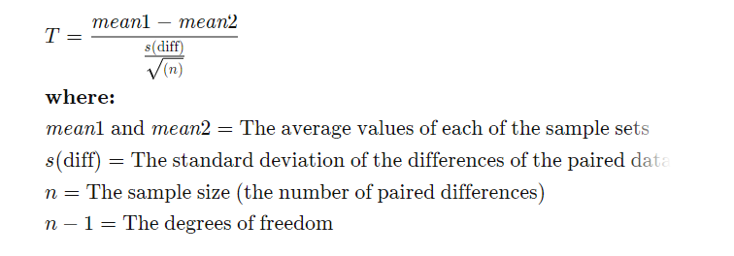

Slide 42
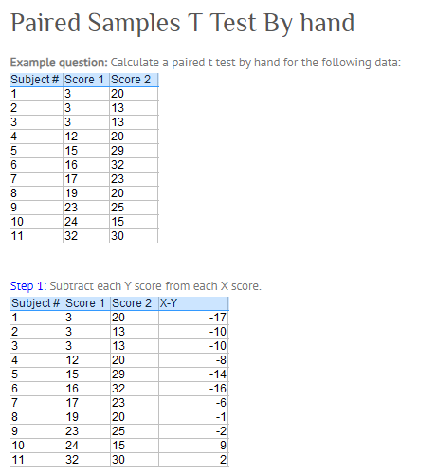

Slide 43
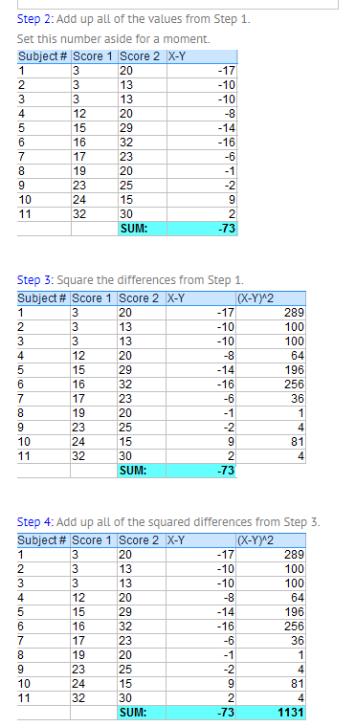

Slide 44
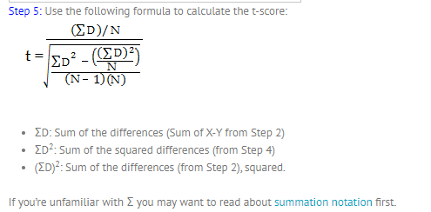

Slide 45
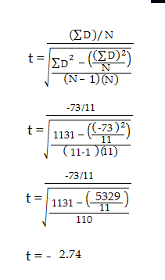

Slide 46
Step 6: Subtract 1 from the sample size to get the degrees of freedom. We have 11 items, so 11-1 = 10.
Step 7: Find the p-value in the t-table, using the degrees of freedom in Step 6. If you don’t have a specified alpha level, use 0.05 (5%). For this example problem, with df = 10, the t-value is 2.228.
Step 8: Compare your t-table value from Step 7 (2.228) to your calculated t-value (-2.74). The calculated t-value is greater than the table value at an alpha level of .05. The p-value is less than the alpha level: p <.05. We can reject the null hypothesis that there is no difference between means.

Slide 47
Determining the Correct T-Test to Use
The following flowchart can be used to determine which t-test should be used based on the characteristics of the sample sets. The key items to be considered include whether the sample records are similar, the number of data records in each sample set, and the variance of each sample set.

Slide 48
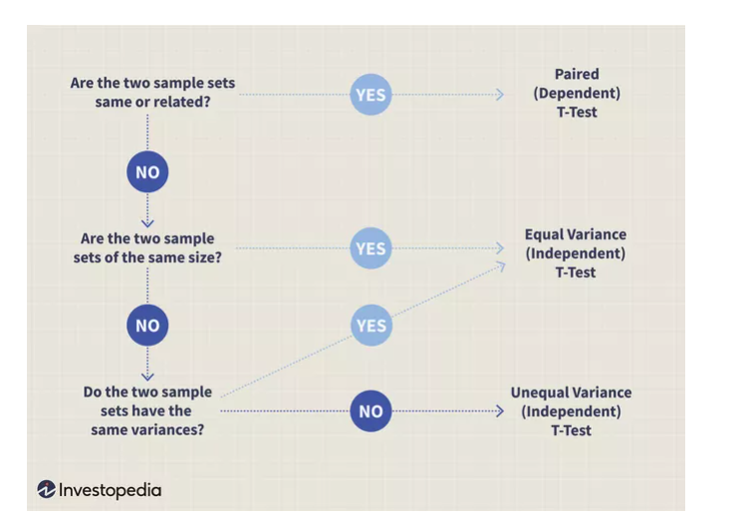

Slide 49
Types of t-test
Depending on the assumptions of your distributions, there are different types of statistical tests.
The assumptions that you have to analyze when deciding the kind of test you have to implement are:
Paired or unpaired: The data of both groups come from the same participants or not.
Parametric or non-parametric: The data are distributed according to some distributions or not.

Slide 50
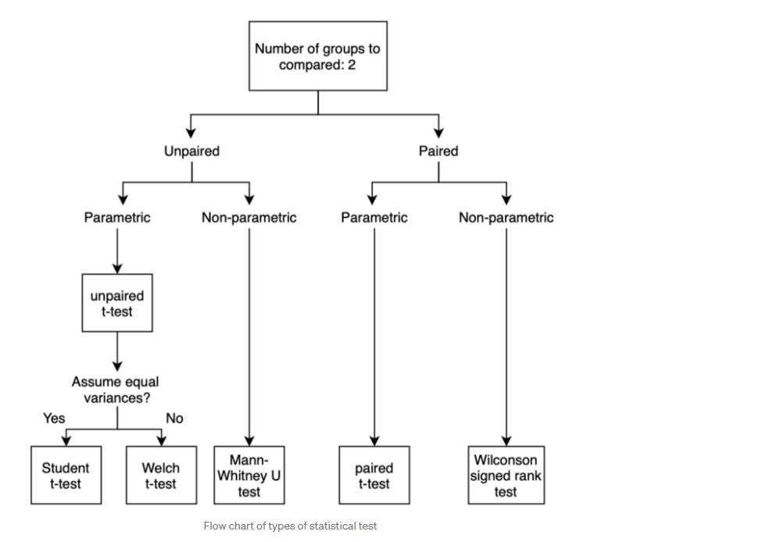

Slide 51
Unpaired t-test
The unpaired t-test (or independent t-test) is a statistical test that determines whether there is a difference between two unrelated groups.

Slide 52
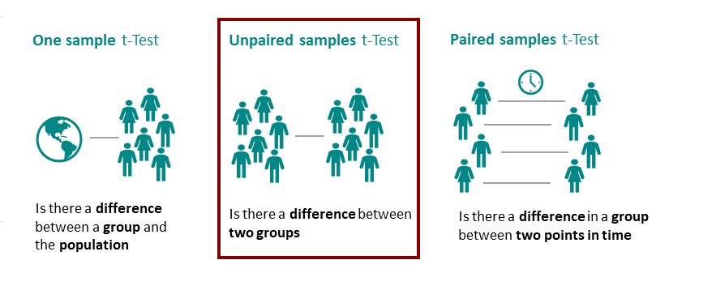

Slide 53
Student T Test

